Slide 1
ECEN 150 Circuit Analysis I
Sinusoids and Complex Numbers.

Slide 2
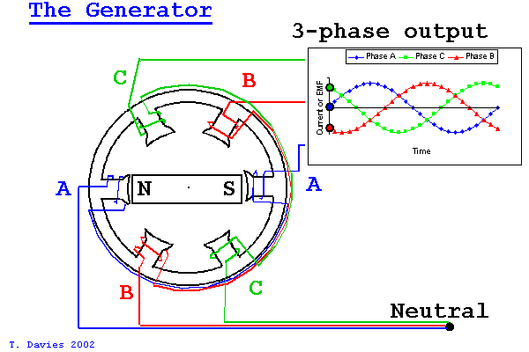
AC Power Generation
AC → Alternating Current. Current alternates (Reverses) direction of flow, repeating the pattern over and over.
Sinusoidal voltages and currents are produced by ac generators and electronic oscillators.
AC implies sinusoids (sines and cosines) for voltage and current.
Most electrical energy is is generated as Three-Phase AC.
Three-phase AC power is generated by a single
rotating magnet surrounded by 6 coils aligned
perfectly so that each phase will create a sinusoid
120° off from each other.
The resulting instantaneous power is never zero,
which is preferred for large AC motors.
Three-phase Delta configuration (3 wires) actually
requires about 25% less conductor volume than single
phase (2 wires) for the same power loss. Hence
three-phase delta is the preferred configuration for
long distance power distribution.

Slide 3
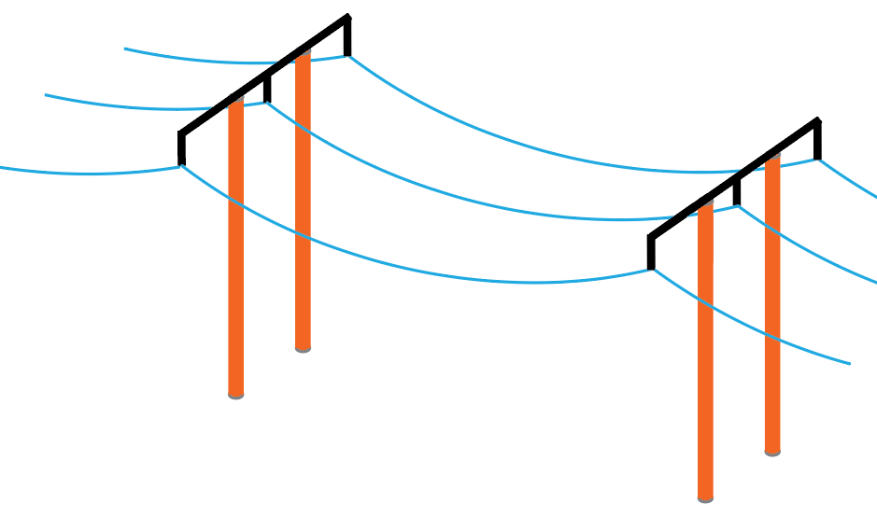
AC Power Distribution
Why is AC more efficient and economical for long distance power transmission than DC?
Transmission line power loss: p_{loss} = i²R_{loss}.
Hence, reducing current significantly reduces power
line loss.
So how do we reduce current for a given power?
Electrical power equals product of voltage and
current, i.e., p = vi.
Can use AC transformers to step up voltage, which
steps down current by the same factor for a given power.
What about p = v²/R?
High voltage on a transmission line does not translate into a large voltage drop across the low resistance lines.
So, high voltage transmission lines can transmit a given power for reduced power loss, because of reduced current.
Modern switching techniques can also be used to step up DC voltages while stepping down DC currents, whereas AC transformers have been doing this for the last 100 years.

Slide 4
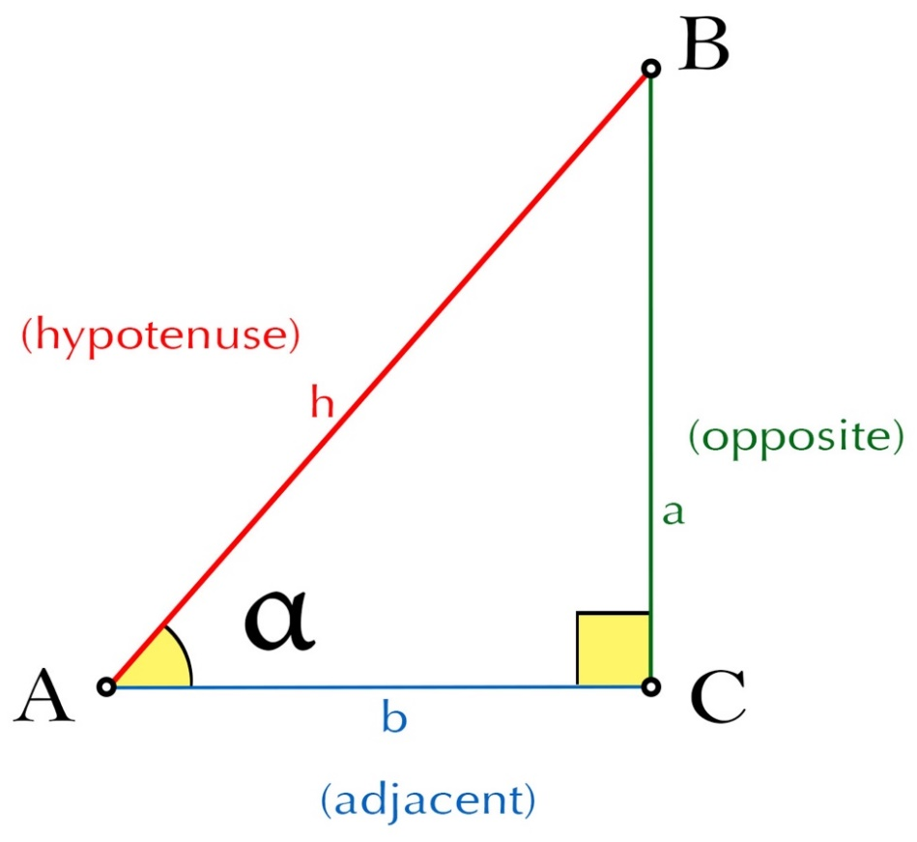
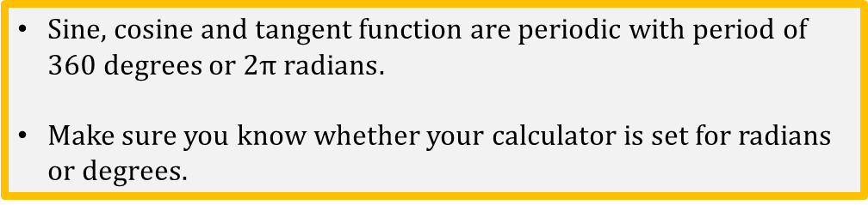
Basic Trigonometric Functions
sin(α) = opposite/hypotenuse
cos(α) = adjacent/hypotenuse
tan(α) = opposite/adjacent
Sine, cosine and tangent function are periodic with period of 360 degrees or $2π radians$.
Make sure you know whether your calculator is set for radians or degrees.
α in Degrees | α in Radians | Sin(α)
0 | 0 | 0.000
45 | π/4 | 0.707
90 | π/2 | 1.00
135 | 3π/4 | 0.707
180 | π | 0.000
225 | 5π/4 | -0.707
270 | 3π/2 | -1.00
315 | 7π/4 | -0.707
360 | 2π | 0.000
Notes:
Image by CCD team of BYUI.

Slide 5
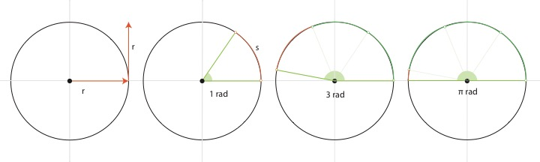
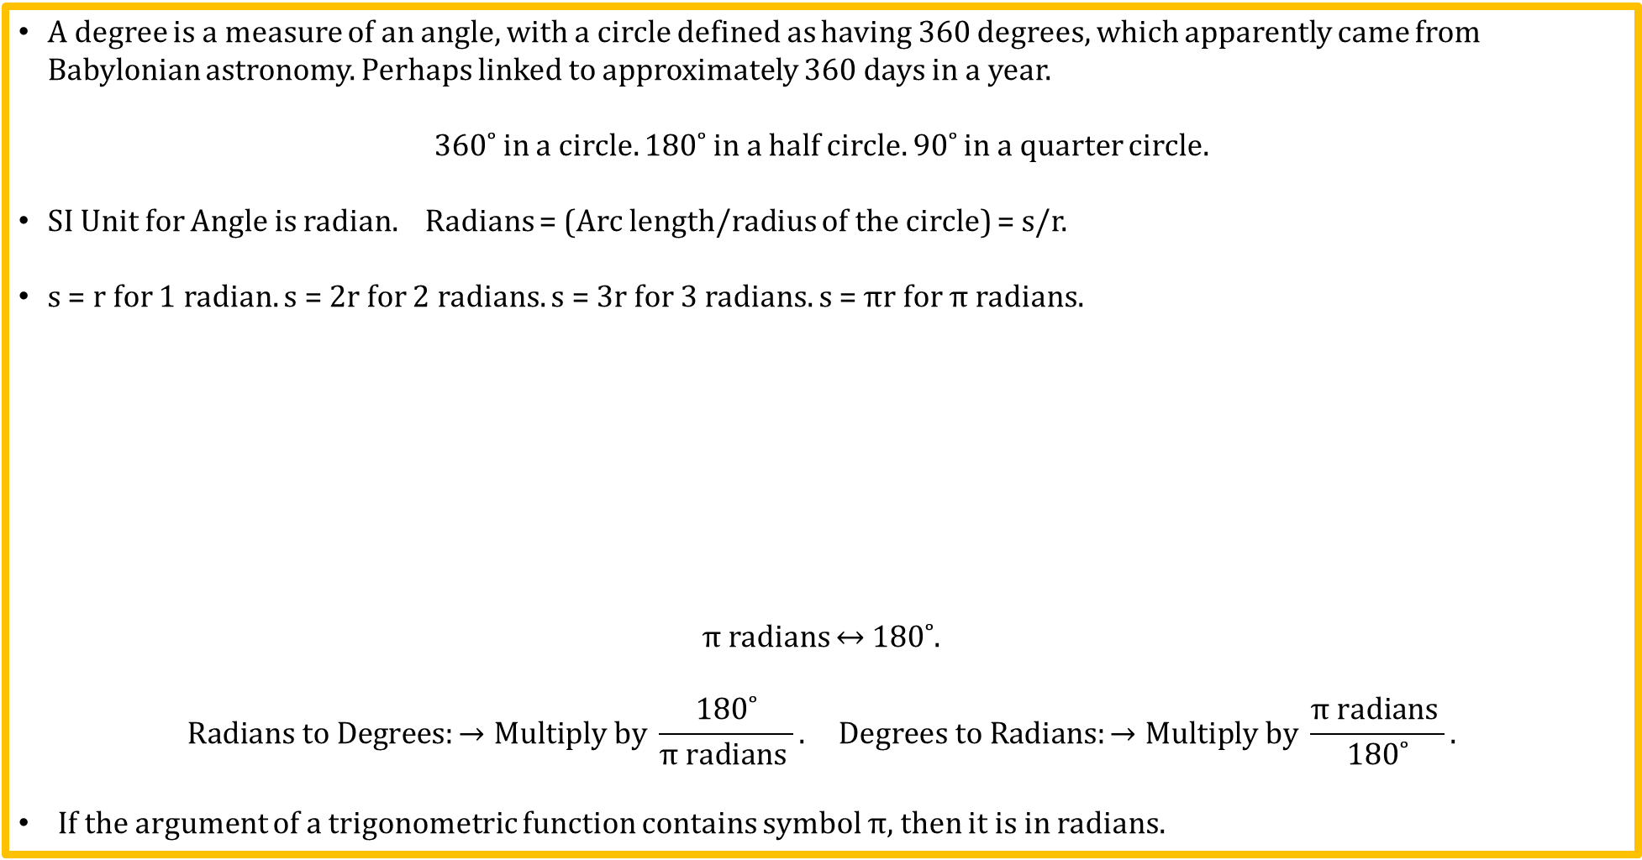
Degrees and Radians
A degree is a measure of an angle, with a circle defined as having 360 degrees, which apparently came from Babylonian astronomy. Perhaps linked to approximately 360 days in a year.
360˚ in a circle. 180˚ in a half circle. 90˚ in a quarter circle.
SI Unit for Angle is radian. Radians = (Arc length/radius of the circle) = s/r.
s = r for 1 radian. s = 2r for 2 radians. s = 3r for 3 radians. s = $π$r for $π$ radians.
$π$ radians ↔ 180˚.
$$Radians to Degrees:→Multiply by \frac{\text{180˚}}{π \text{radians} }. Degrees to Radians:→Multiply by \frac{π \text{radians} }{\text{180˚}}.$$
If the argument of a trigonometric function contains symbol $π$, then it is in radians.
Notes:
Image created by CCD team of BYUI.

Slide 6
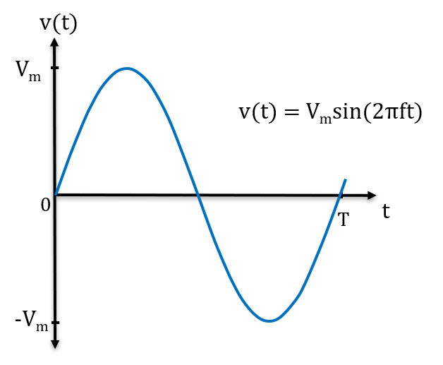
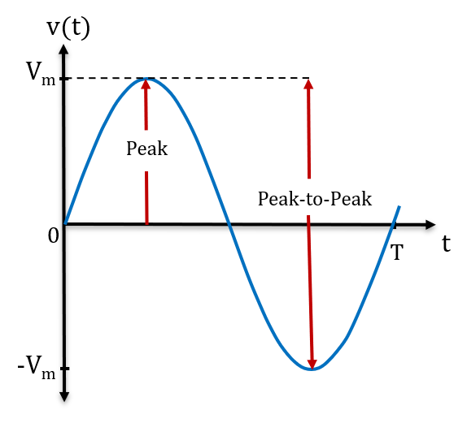
Sinusoids – Sines and Cosines
In Electrical Engineering sinusoids are used to describe voltages and currents associated with ac power, along with signals to be processed measured.
Sinusoids repeat, and are therefore referred to as periodic functions with period T.
sin(2πft) and cos(2πft) = 1, at the peak value V_{m}. So don’t need time t to determine the peak and peak-to-peak values, rather just need to know V_{m}.
V_{peak} = V_{m}, and V_{peak-to-peak} = 2V_{m}.
Need to understand sinusoids for Electrical Engineering and signal processing.

Slide 7
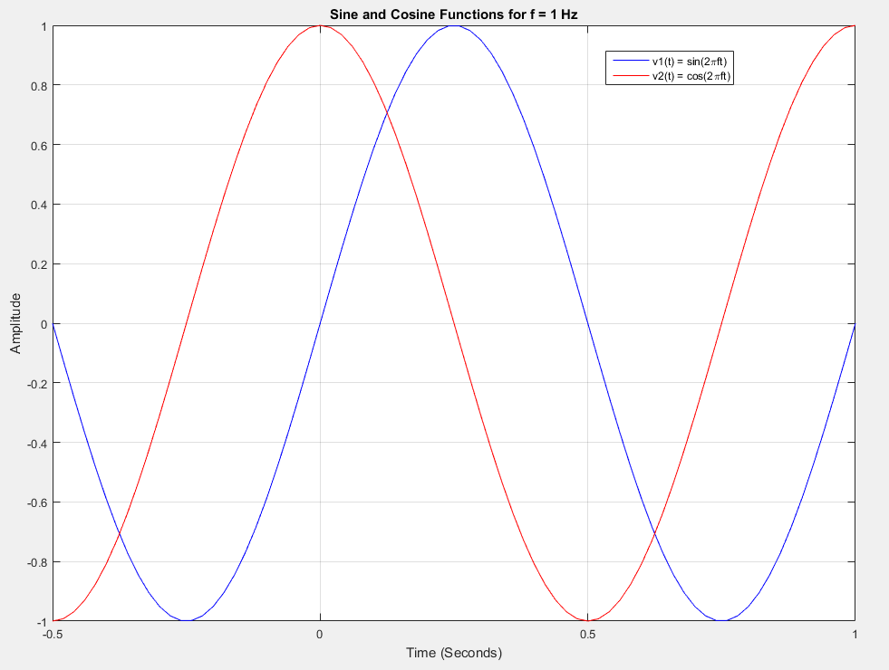
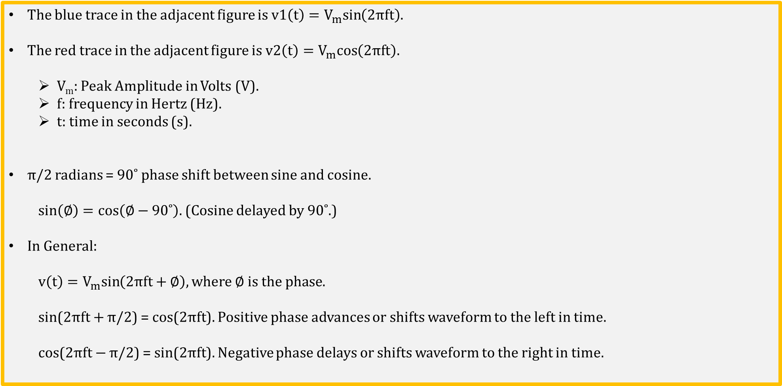
Sine and Cosine Waveforms
The blue trace in the adjacent figure is v1$\left(t\right)=V_{m}sin\left(2πft\right).$
The red trace in the adjacent figure is v2$\left(t\right)=V_{m}cos\left(2πft\right).$
V_{m}: Peak Amplitude in Volts (V).
f: frequency in Hertz (Hz).
t: time in seconds (s).
π/2 radians = 90˚ phase shift between sine and cosine.
$sin\left(∅\right)=cos\left(∅−90˚\right).$ (Cosine delayed by 90˚.)
In General:
v$\left(t\right)=V_{m}sin\left(2πft+∅\right), where ∅ is the phase.$
sin($2πft+$ π/2) = cos($2πft$). Positive phase advances or shifts waveform to the left in time.
cos($2πft−$ π/2) = sin($2πft$). Negative phase delays or shifts waveform to the right in time.
Notes:
Image by instructor

Slide 8
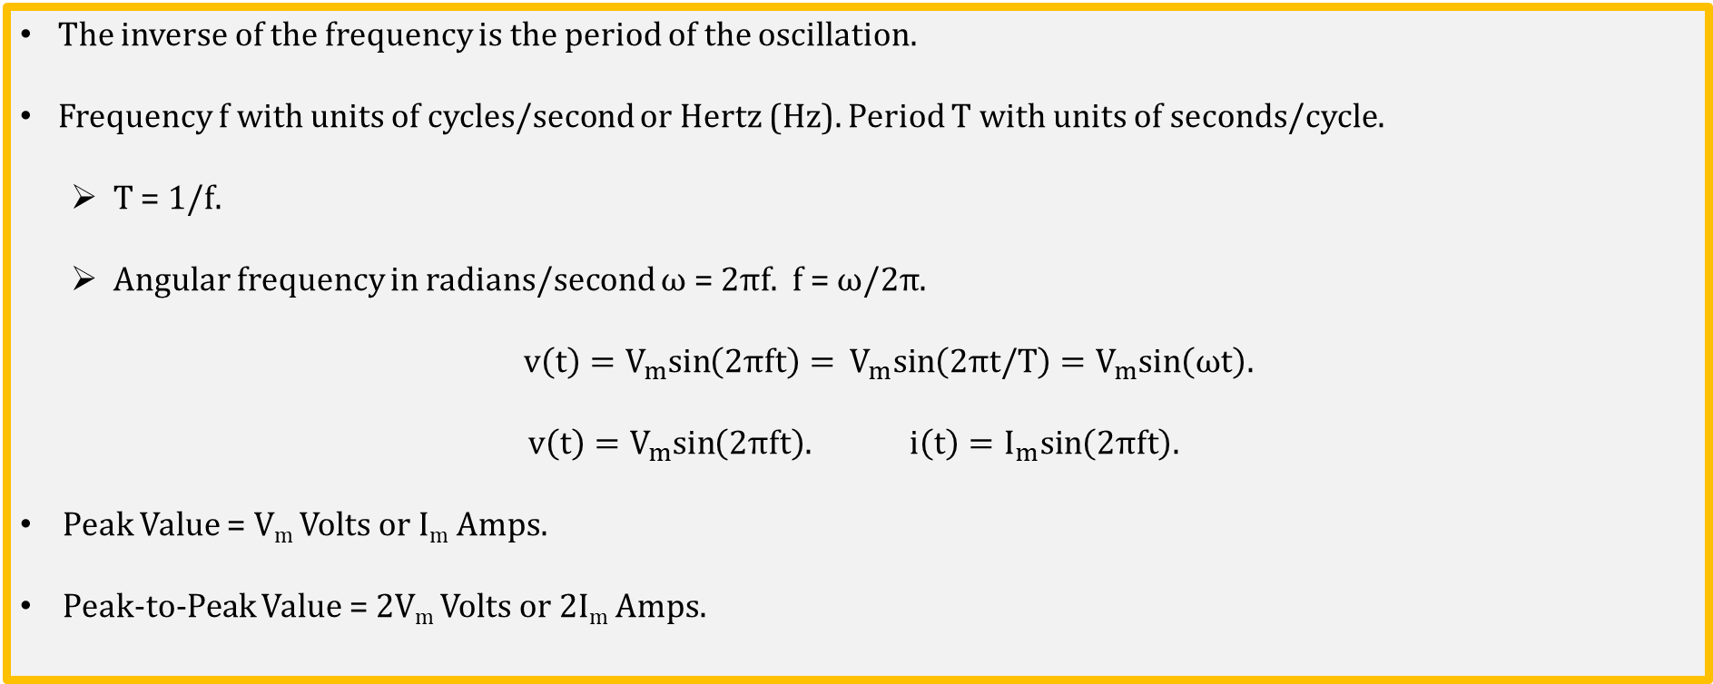
Sinusoidal Signals
The inverse of the frequency is the period of the oscillation.
Frequency f with units of cycles/second or Hertz (Hz). Period T with units of seconds/cycle.
T = 1/f.
Angular frequency in radians/second ω = $2πf$. f = ω/$2π$.
v$\left(t\right)=V_{m}sin\left(2πft\right)=$ $V_{m}sin\left(2πt/T\right)=V_{m}sin\left(ωt\right).$
v$\left(t\right)=V_{m}sin\left(2πft\right).$ i$\left(t\right)=I_{m}sin\left(2πft\right).$
Peak Value = V_{m} Volts or I_{m} Amps.
Peak-to-Peak Value = 2V_{m} Volts or 2I_{m} Amps.
Poll Questions

Slide 9
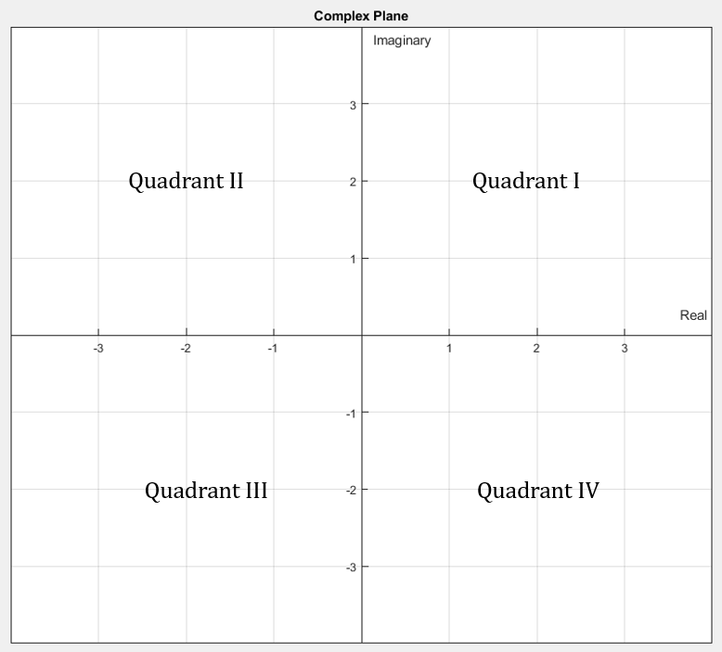
Complex Numbers – See Appendix B
Imaginary numbers had no practical use in engineering
until John Wallis in 1685 proposed using complex numbers,
i.e., numbers with both a real and imaginary component such
as 1 + j3, as points on a plane.
Mathematicians use i to designate the “Imaginary” unit,
although Electrical Engineers use j for imaginary unit since
i is used for current.
Electrical Engineers use the complex plane as a method
of representing phase shifted sinusoids.
The peak amplitude of sinusoides are represented by the
magnitude of complex numbers, with the phase shift represented
by the associated angles in the complex plane.
This representation is referred to as a Phase Vector or Phasor, to be discussed next time.

Slide 10
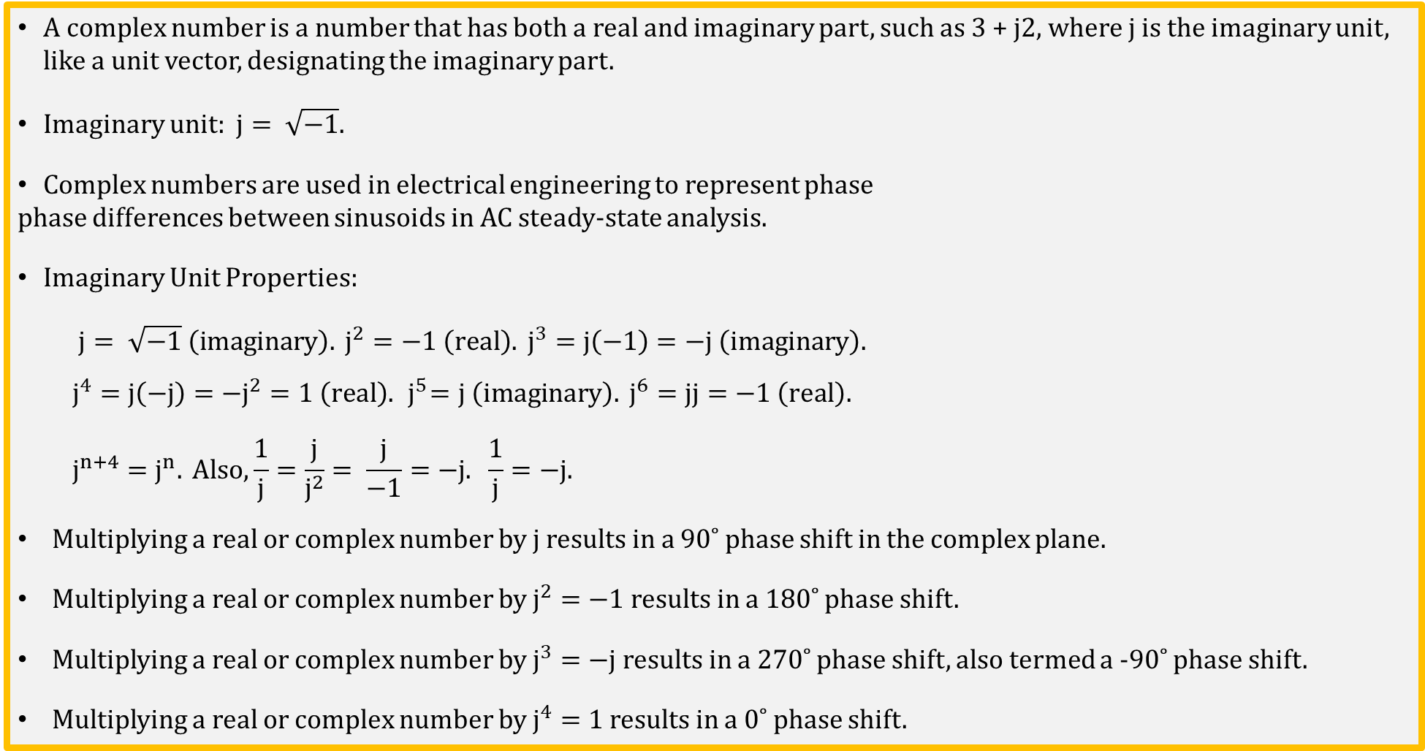
Complex Numbers (Continued)
A complex number is a number that has both a real and imaginary part, such as 3 + j2, where j is the imaginary unit, like a unit vector, designating the imaginary part.
Imaginary unit: $j= \sqrt{−1}$.
Complex numbers are used in electrical engineering to represent phase
phase differences between sinusoids in AC steady-state analysis.
Imaginary Unit Properties:
$j= \sqrt{−1} \left(imaginary\right). j^{2}=−1 \left(real\right). j^{3}=j\left(−1\right)=−j \left(imaginary\right).$
$j^{4}=j\left(−j\right)=−j^{2}=1 \left(real\right).{ j}^{5}=j \left(imaginary\right). j^{6}=jj=−1 \left(real\right).$
$$j^{n+4}=j^{n}. Also, \frac{1}{j}=\frac{j}{j^{2}}= \frac{j}{−1}=−j. \frac{1}{j}=−j.$$
Multiplying a real or complex number by j results in a 90˚ phase shift in the complex plane.
Multiplying a real or complex number by $j^{2}=−1$results in a 180˚ phase shift.
Multiplying a real or complex number by $j^{3}=−j$results in a 270˚ phase shift, also termed a -90˚ phase shift.
Multiplying a real or complex number by $j^{4}=1$results in a 0˚ phase shift.

Slide 11
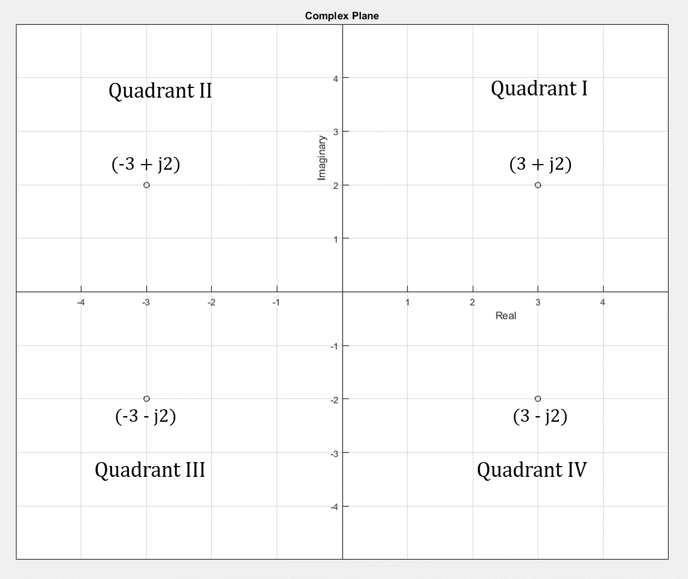
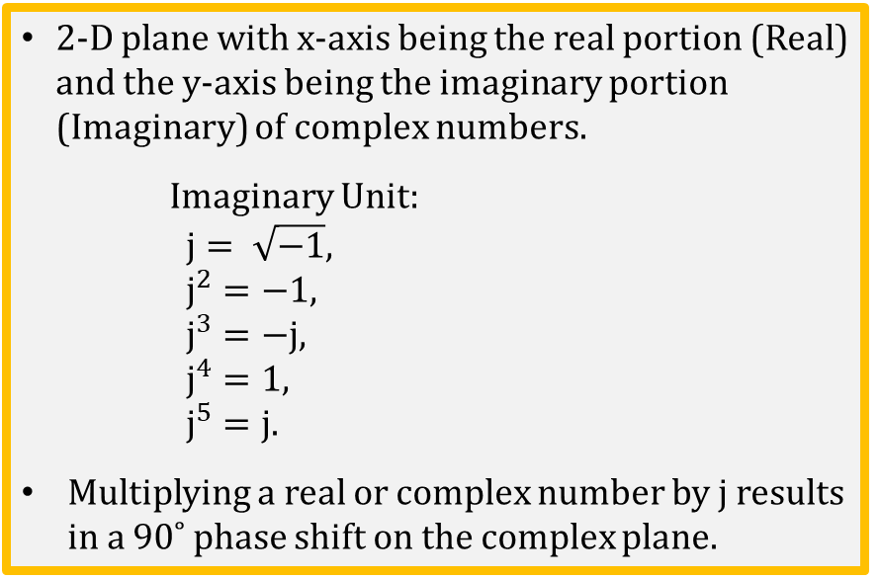
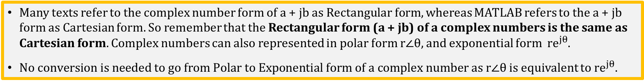
Complex Plane
2-D plane with x-axis being the real portion (Real) and the y-axis being the imaginary portion (Imaginary) of complex numbers.
Imaginary Unit:
$j= \sqrt{−1},$
$j^{2}=−1,$
$j^{3}=−j,$
$j^{4}=1,$
$j^{5}=j.$
Multiplying a real or complex number by j results in a 90˚ phase shift on the complex plane.
Many texts refer to the complex number form of a + jb as Rectangular form, whereas MATLAB refers to the a + jb form as Cartesian form. So remember that the Rectangular form (a + jb) of a complex numbers is the same as Cartesian form. Complex numbers can also represented in polar form $r∠θ,$ and exponential form $re^{jθ}$.
$No conversion is needed to go from Polar to Exponential form of a complex number as r∠θ$ is equivalent to $re^{jθ}.$

Slide 12
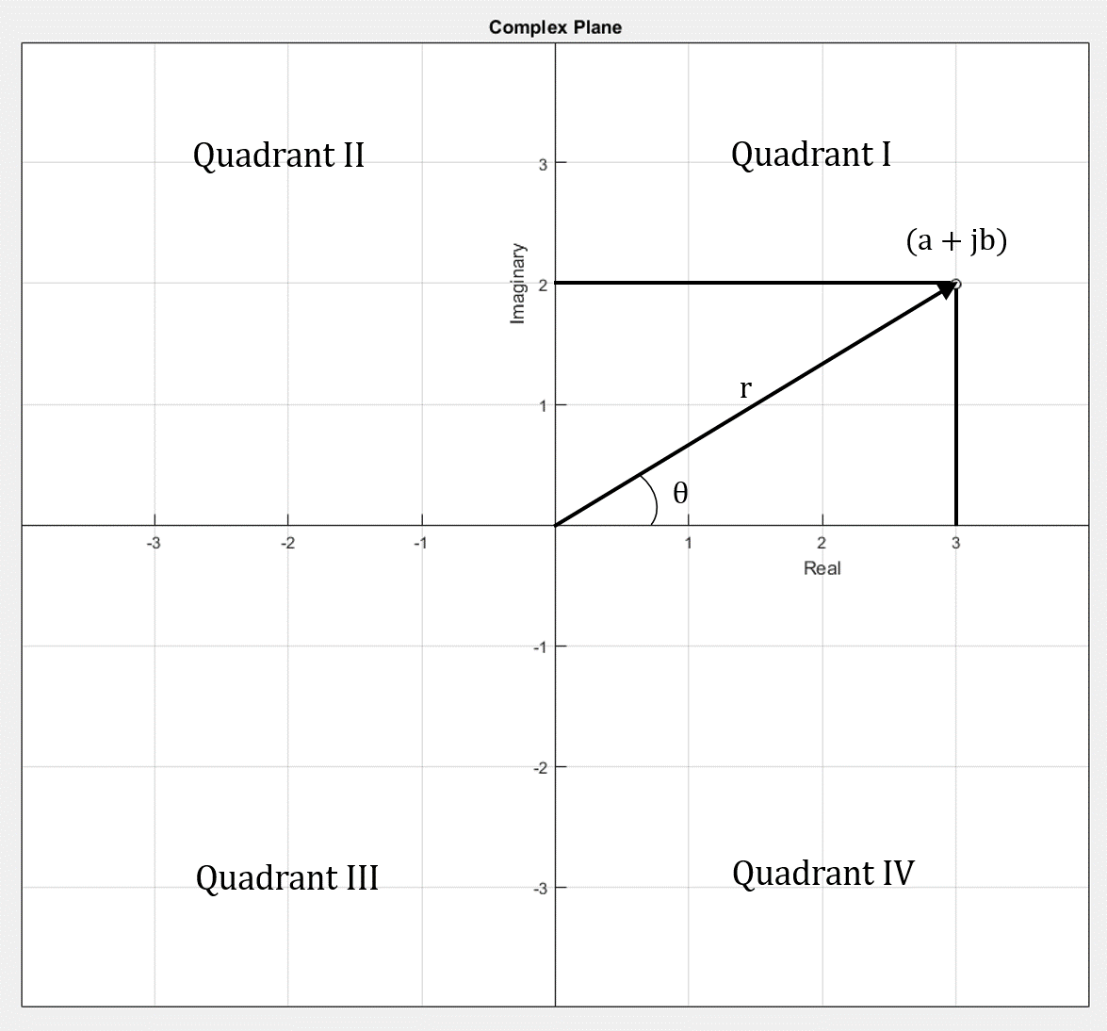
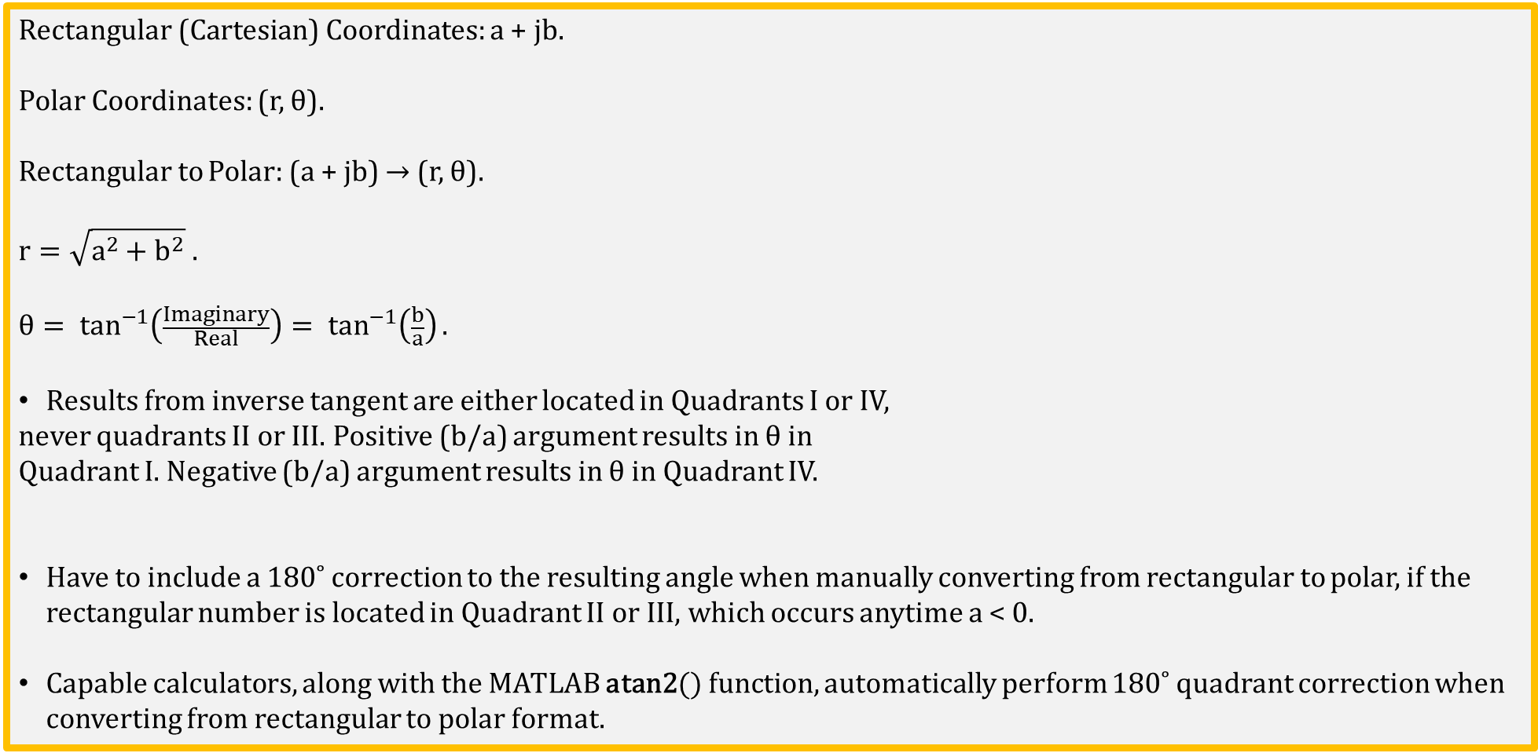
Rectangular (Cartesian) to Polar Form
Rectangular (Cartesian) Coordinates: a + jb.
Polar Coordinates: (r, θ).
Rectangular to Polar: (a + jb) → (r, θ).
$$r=\sqrt{a^{2}+b^{2}} .$$
$$θ= \tan^{−1}\left(\frac{Imaginary}{Real}\right)= \tan^{−1}\left(\frac{b}{a}\right).$$
Results from inverse tangent are either located in Quadrants I or IV,
never quadrants II or III. Positive (b/a) argument results in θ in
Quadrant I. Negative (b/a) argument results in θ in Quadrant IV.
Have to include a 180˚ correction to the resulting angle when manually converting from rectangular to polar, if the rectangular number is located in Quadrant II or III, which occurs anytime a < 0.
Capable calculators, along with the MATLAB atan2() function, automatically perform 180˚ quadrant correction when converting from rectangular to polar format.

Slide 13
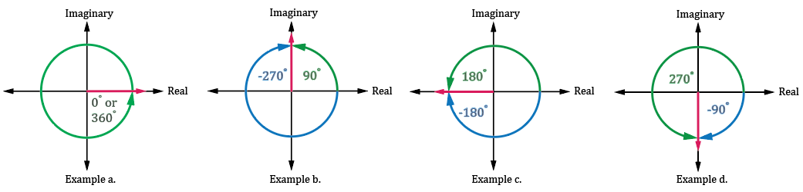
Positive versus Negative Angles
Angles in polar coordinates can be designated as either positive or negative angles, with positive angles rotating Counter Clockwise from 0˚ on the real axis with negative angles rotating Clockwise from 0˚ on the real axis.
The convention is to choose the angle that has the smallest magnitude. For equal magnitudes, choose the positive angle. Hence, the angles shown in examples a, b and c above are best denoted as follows:
a. 0˚.
b. 90˚.
c. 180˚.
d. -90˚.

Slide 14
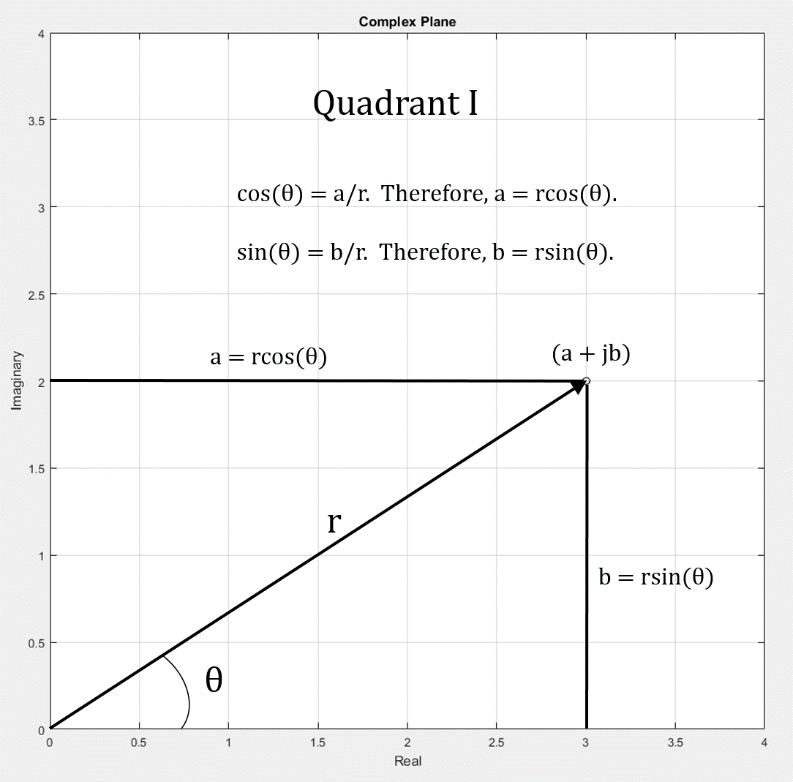
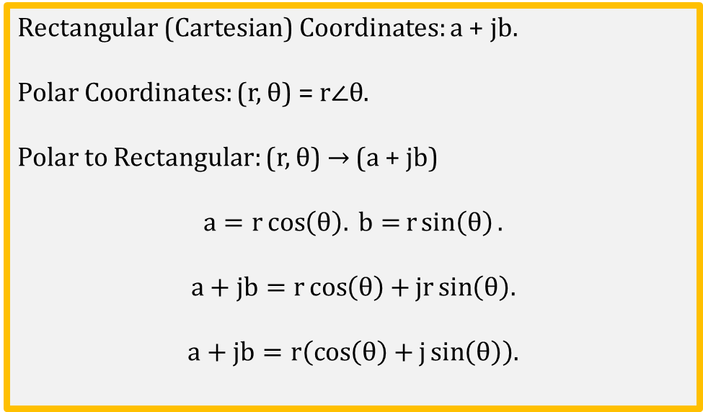
Polar to Rectangular (Cartesian) Conversion
Rectangular (Cartesian) Coordinates: a + jb.
Polar Coordinates: (r, θ) = $r∠θ$.
Polar to Rectangular: (r, θ) → (a + jb)
$$a=r\cos\left(θ\right). b=r\sin\left(θ\right).$$
$$a+jb=r\cos\left(θ\right)+jr\sin\left(θ\right).$$
$$a+jb=r\left(\cos\left(θ\right)+j\sin\left(θ\right)\right).$$
Notes:
Image created by CCD team of BYUI.

Slide 15
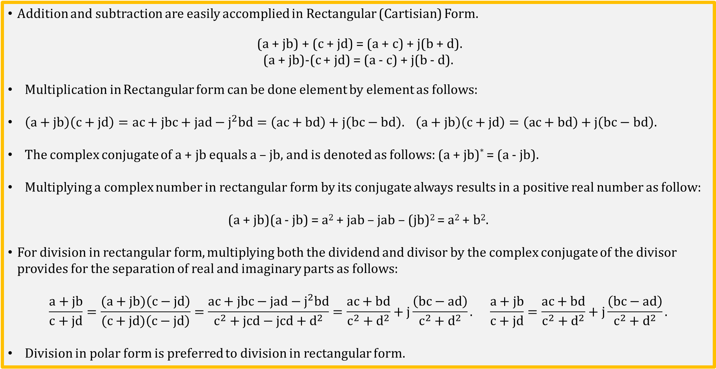
Basic Rectangular (Cartisian) Form Math
Addition and subtraction are easily accomplied in Rectangular (Cartisian) Form.
(a + jb) + (c + jd) = (a + c) + j(b + d).
(a + jb)-(c + jd) = (a - c) + j(b - d).
Multiplication in Rectangular form can be done element by element as follows:
$\left(a+jb\right)\left(c+jd\right)=ac+jbc+jad−j^{2}bd=\left(ac+bd\right)+j\left(bc−bd\right). \left(a+jb\right)\left(c+jd\right)=\left(ac+bd\right)+j\left(bc−bd\right).$
The complex conjugate of a + jb equals a – jb, and is denoted as follows: (a + jb)* = (a - jb).
Multiplying a complex number in rectangular form by its conjugate always results in a positive real number as follow:
(a + jb)(a - jb) = a² + jab – jab – (jb)² = a² + b².
For division in rectangular form, multiplying both the dividend and divisor by the complex conjugate of the divisor provides for the separation of real and imaginary parts as follows:
$$\frac{a+jb}{c+jd}=\frac{(a+jb)\left(c−jd\right)}{(c+jd)\left(c−jd\right)}=\frac{ac+jbc−jad−j^{2}bd}{c^{2}+jcd−jcd+d^{2}}=\frac{ac+bd}{c^{2}+d^{2}}+j\frac{\left(bc−ad\right)}{c^{2}+d^{2}}. \frac{a+jb}{c+jd}=\frac{ac+bd}{c^{2}+d^{2}}+j\frac{\left(bc−ad\right)}{c^{2}+d^{2}}.$$
Division in polar form is preferred to division in rectangular form.

Slide 16
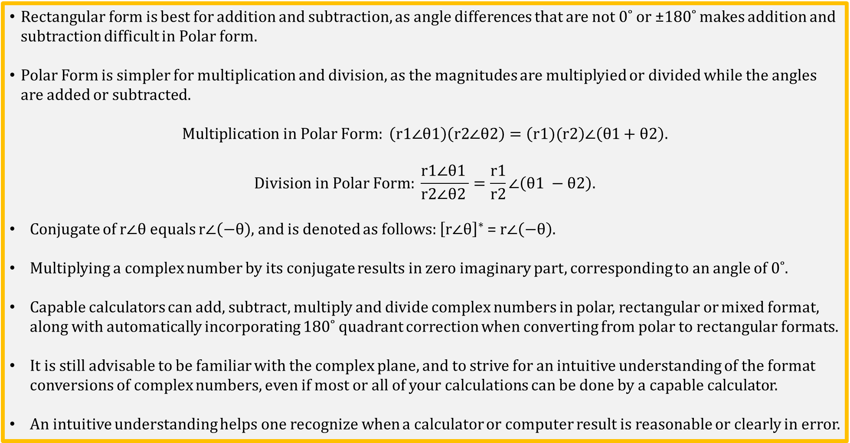
Basic Polar Form Math
Rectangular form is best for addition and subtraction, as angle differences that are not 0˚ or ±180˚ makes addition and subtraction difficult in Polar form.
Polar Form is simpler for multiplication and division, as the magnitudes are multiplyied or divided while the angles are added or subtracted.
$$Multiplication in Polar Form: \left(\text{r}\text{1}∠θ1\right)\left(\text{r}2∠θ2\right)=\left(\text{r}1)(\text{r}2\right)∠\left(θ1+θ2\right).$$
$$Division in Polar Form: \frac{\text{r}1∠θ1 }{\text{r}2∠θ2 }=\frac{\text{r}1}{\text{r}2}∠\left(θ1 −θ2\right).$$
Conjugate of $\text{r}∠θ$ equals $\text{r}∠\left(−θ\right),$ and is denoted as follows: ${\left[\text{r}∠θ\right]}^{∗}$ = $\text{r}∠\left(−θ\right).$
Multiplying a complex number by its conjugate results in zero imaginary part, corresponding to an angle of 0˚.
Capable calculators can add, subtract, multiply and divide complex numbers in polar, rectangular or mixed format, along with automatically incorporating 180˚ quadrant correction when converting from polar to rectangular formats.
It is still advisable to be familiar with the complex plane, and to strive for an intuitive understanding of the format conversions of complex numbers, even if most or all of your calculations can be done by a capable calculator.
An intuitive understanding helps one recognize when a calculator or computer result is reasonable or clearly in error.

Slide 17
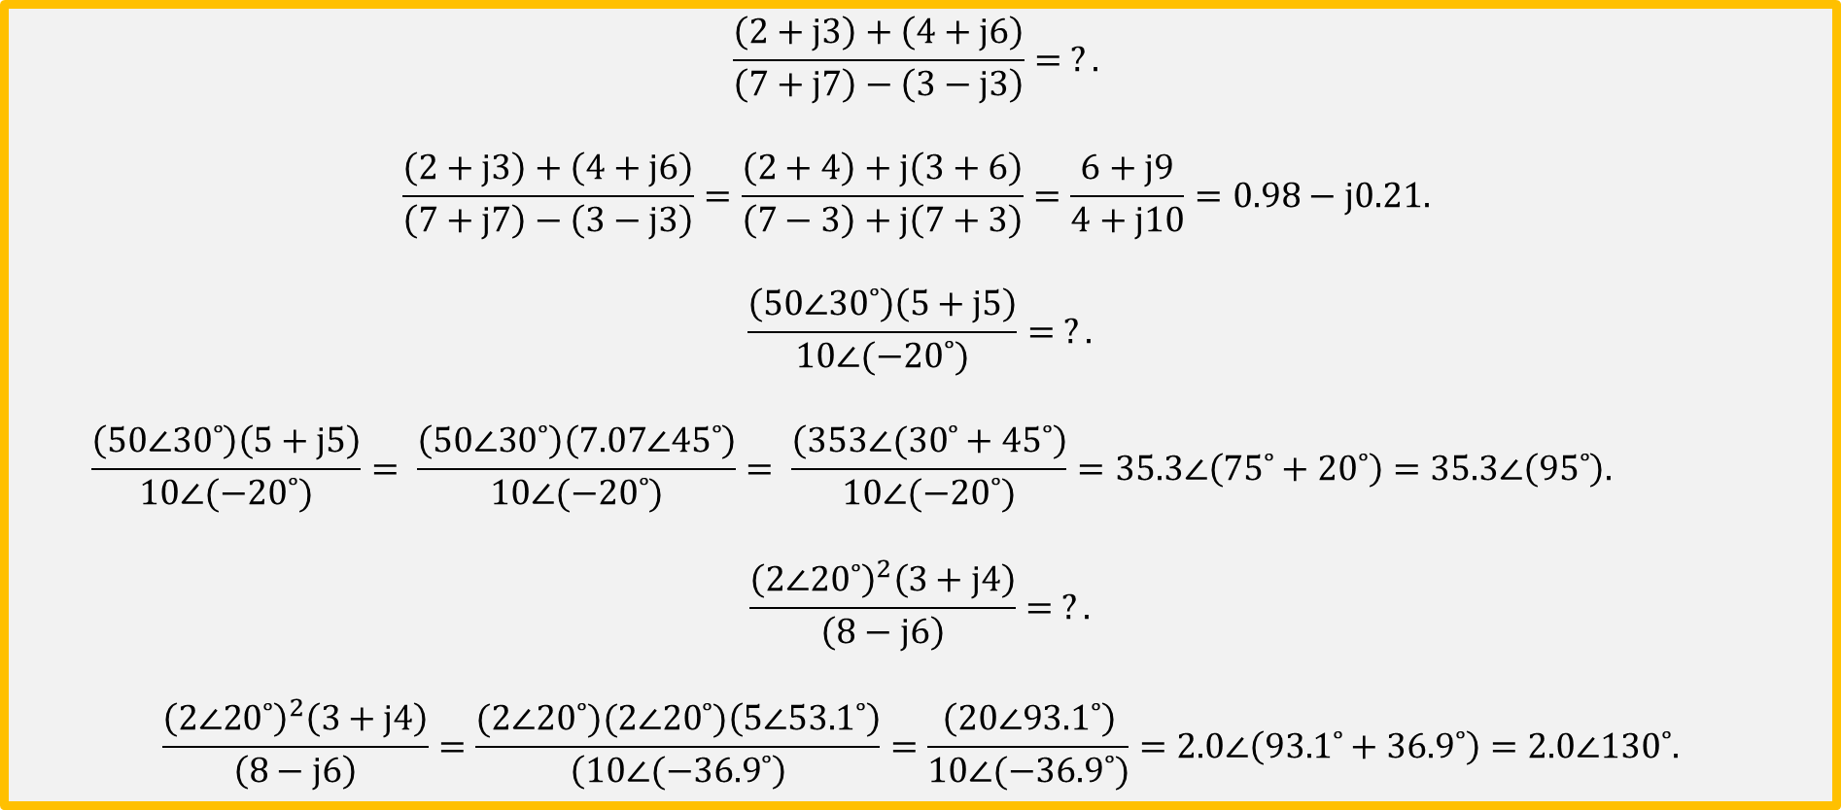
Complex Math Examples Using a Calculator
$$\frac{\left(2+j3\right)+\left(4+j6\right)}{\left(7+j7\right)−\left(3−j3\right)}= ?.$$
$$\frac{\left(2+j3\right)+\left(4+j6\right)}{\left(7+j7\right)−\left(3−j3\right)}=\frac{\left(2+4\right)+j\left(3+6\right)}{\left(7−3\right)+j\left(7+3\right)}=\frac{6+j9}{4+j10}=0.98−j0.21.$$
$$\frac{\left(\text{50}∠30˚\right)\left(5+j5\right)}{\text{10}∠(−20˚)}= ?.$$
$$\frac{\left(\text{50}∠30˚\right)\left(5+j5\right)}{\text{10}∠(−20˚)}= \frac{\left(\text{50}∠30˚\right)\left(\text{7.}\text{0}\text{7}∠45˚\right)}{\text{10}∠(−20˚)}= \frac{\left(\text{353}∠(30˚+45˚\right)}{\text{10}∠(−20˚)}=35.3∠\left(75˚+20˚\right)=35.3∠\left(95˚\right).$$
$$\frac{{\left(\text{2}∠20˚\right)}^{2}\left(3+j4\right)}{\left(8−j6\right)}= ?.$$
$$\frac{{\left(\text{2}∠20˚\right)}^{2}\left(3+j4\right)}{\left(8−j6\right)}=\frac{(\text{2}∠20˚)(\text{2}∠20˚)\left(\text{5}∠53.1˚\right)}{\left(\text{1}\text{0}∠(−36.9˚\right)}=\frac{\left(\text{2}\text{0}∠93.1˚\right)}{\text{10}∠(−36.9˚)}=2.0∠\left(93.1˚+36.9˚\right)=2.0∠130˚.$$

Slide 18
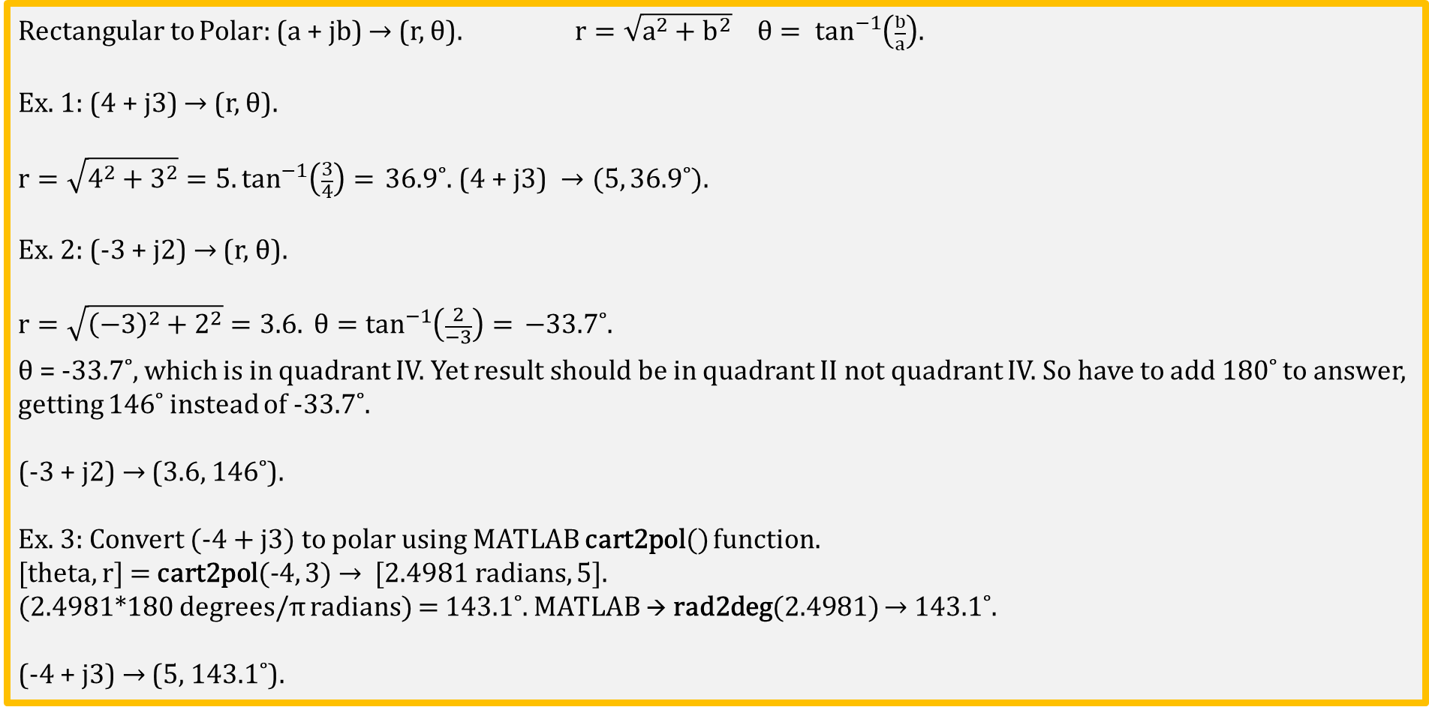
Rectangular to Polar Form Conversion Examples
Rectangular to Polar: (a + jb) → (r, θ). $r=\sqrt{a^{2}+b^{2}} θ= \tan^{−1}\left(\frac{b}{a}\right).$
Ex. 1: (4 + j3) → (r, θ).
$$r=\sqrt{4^{2}+3^{2}}=5.\tan^{−1}\left(\frac{3}{4}\right)= \text{36.9˚}\text{. (4 + }\text{j}\text{3) }→(5, 36.9˚).$$
Ex. 2: (-3 + j2) → (r, θ).
$$r=\sqrt{{\left(−3\right)}^{2}+2^{2}}=3.6. θ=\tan^{−1}\left(\frac{2}{−3}\right)= \text{−33.7}\text{˚}\text{.}$$
θ = -33.7˚, which is in quadrant IV. Yet result should be in quadrant II not quadrant IV. So have to add 180˚ to answer, getting 146˚ instead of -33.7˚.
(-3 + j2) → (3.6, 146˚).
Ex. 3: Convert (-4 + j3) to polar using MATLAB cart2pol() function.
[theta, r] = cart2pol(-4, 3) → [2.4981 radians, 5].
(2.4981*180 degrees/π radians) = 143.1˚. MATLAB → rad2deg(2.4981) → 143.1˚.
(-4 + j3) → (5, 143.1˚).

Slide 19
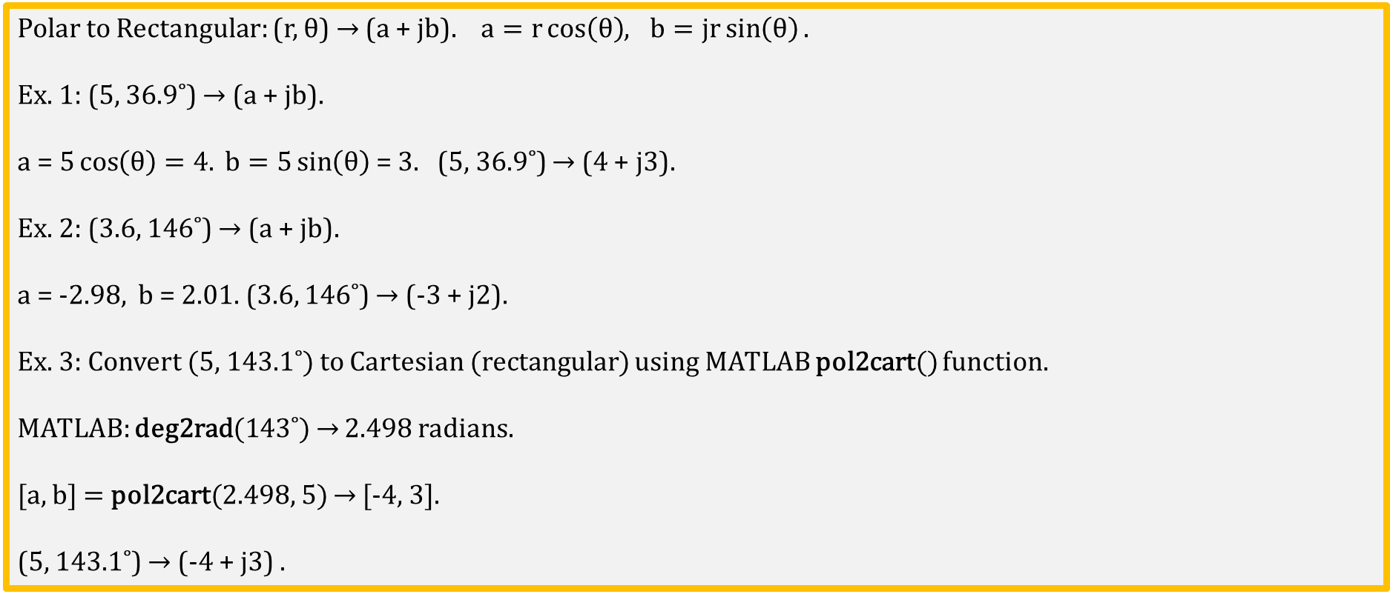
Polar to Rectangular Form Conversion Examples
Polar to Rectangular: (r, θ) → (a + jb). $a=r\cos\left(θ\right){, b=jr\sin\left(θ\right).}$
Ex. 1: (5, 36.9˚) → (a + jb).
a =$5\cos\left(θ\right)=4.{ b=5\sin\left(θ\right)}$= 3. (5, 36.9˚) → (4 + j3).
Ex. 2: (3.6, 146˚) → (a + jb).
a = -2.98, b = 2.01. (3.6, 146˚) → (-3 + j2).
Ex. 3: Convert (5, 143.1˚) to Cartesian (rectangular) using MATLAB pol2cart() function.
MATLAB: deg2rad(143˚) → 2.498 radians.
[a, b] = pol2cart(2.498, 5) → [-4, 3].
(5, 143.1˚) → (-4 + j3) .

Slide 20
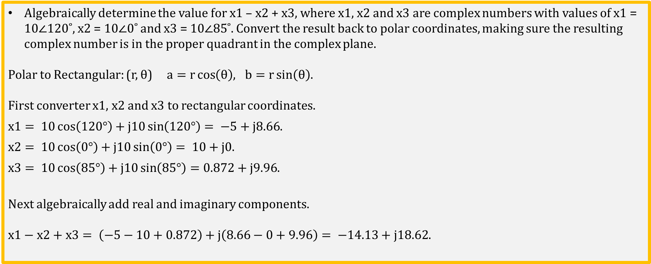
Complex Math Example Using Conversion Formulas
Algebraically determine the value for x1 – x2 + x3, where x1, x2 and x3 are complex numbers with values of x1 = 10$∠$120˚, x2 = 10$∠$0˚ and x3 = 10$∠85$˚. Convert the result back to polar coordinates, making sure the resulting complex number is in the proper quadrant in the complex plane.
Polar to Rectangular: (r, θ) $a=r\cos\left(θ\right){, b=r\sin\left(θ\right)}$.
First converter x1, x2 and x3 to rectangular coordinates.
$x1= 10\cos\left(120°\right)+j10\sin\left(120°\right)= −5+j8.66$.
$x2= 10\cos\left(0°\right)+j10\sin\left(0°\right)= 10+j0$.
$x3= 10\cos\left(85°\right)+j10\sin\left(85°\right)=0.872+j9.96$.
Next algebraically add real and imaginary components.
$x1−x2+x3= \left(−5−10+0.872\right)+j\left(8.66−0+9.96\right)= −14.13+j18.62$.

Slide 21
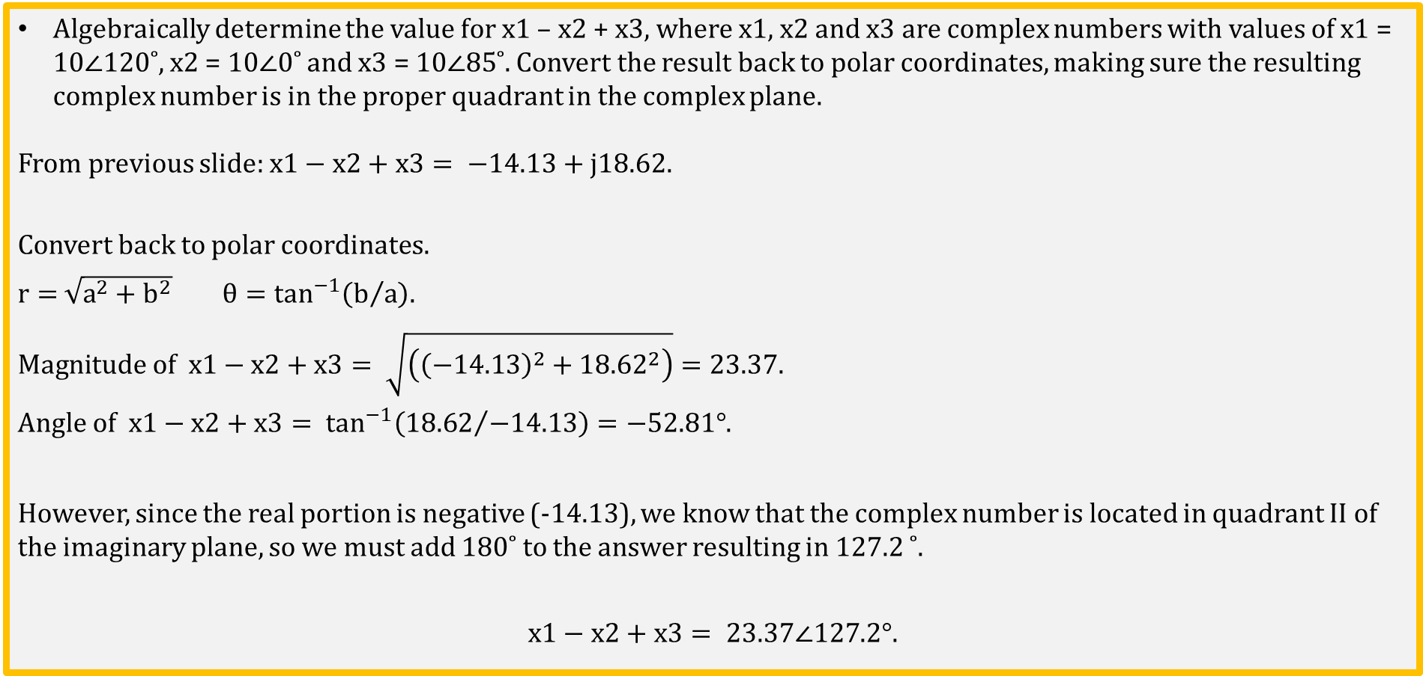
Complex Math Example (Continued)
Algebraically determine the value for x1 – x2 + x3, where x1, x2 and x3 are complex numbers with values of x1 = 10$∠$120˚, x2 = 10$∠$0˚ and x3 = 10$∠85$˚. Convert the result back to polar coordinates, making sure the resulting complex number is in the proper quadrant in the complex plane.
From previous slide: $x1−x2+x3= −14.13+j18.62.$
Convert back to polar coordinates.
$r=$ $\sqrt{a^{2}+b^{2}} θ=\tan^{−1}\left(b/a\right)$.
$Magnitude of x1−x2+x3= \sqrt{\left({\left(−14.13\right)}^{2}+{18.62}^{2}\right)}=23.37$.
$Angle of x1−x2+x3= \tan^{−1}\left({18.62}/{−14.13}\right)=−52.81°$.
However, since the real portion is negative (-14.13), we know that the complex number is located in quadrant II of the imaginary plane, so we must add 180˚ to the answer resulting in 127.2 ˚.
$$x1−x2+x3= 23.37∠127.2°.$$

Slide 22
The End

Slide 23
Extra

Slide 24
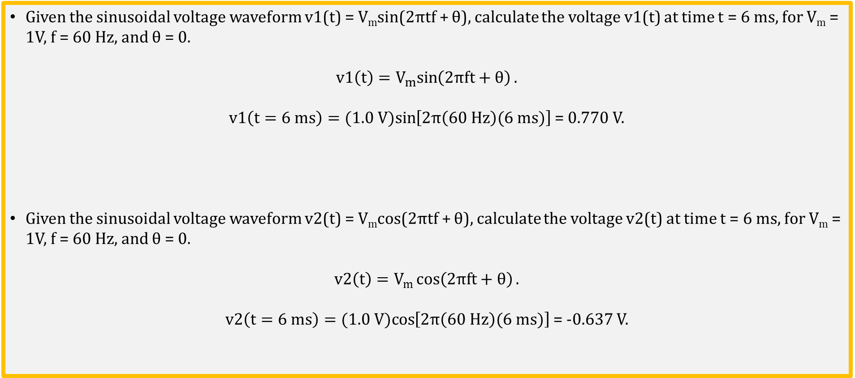
Sinusoidal Waveform Examples
Given the sinusoidal voltage waveform v1(t) = V_{m}sin(2πtf + θ), calculate the voltage v1(t) at time t = 6 ms, for V_{m} = 1V, f = 60 Hz, and θ = 0.
v1$\left(t\right)=V_{m}sin\left(2πft+θ\right).$
v1$\left(t=6 ms\right)=(1.0 V)sin\left[2π\left(60 Hz\right)(6 ms)\right]$ = 0.770 V.
Given the sinusoidal voltage waveform v2(t) = V_{m}cos(2πtf + θ), calculate the voltage v2(t) at time t = 6 ms, for V_{m} = 1V, f = 60 Hz, and θ = 0.
v2$\left(t\right)=V_{m}{cos\left(2πft+θ\right)}.$
v2$\left(t=6 ms\right)=(1.0 V)cos\left[2π\left(60 Hz\right)(6 ms)\right]$ = -0.637 V.
radians

Slide 25

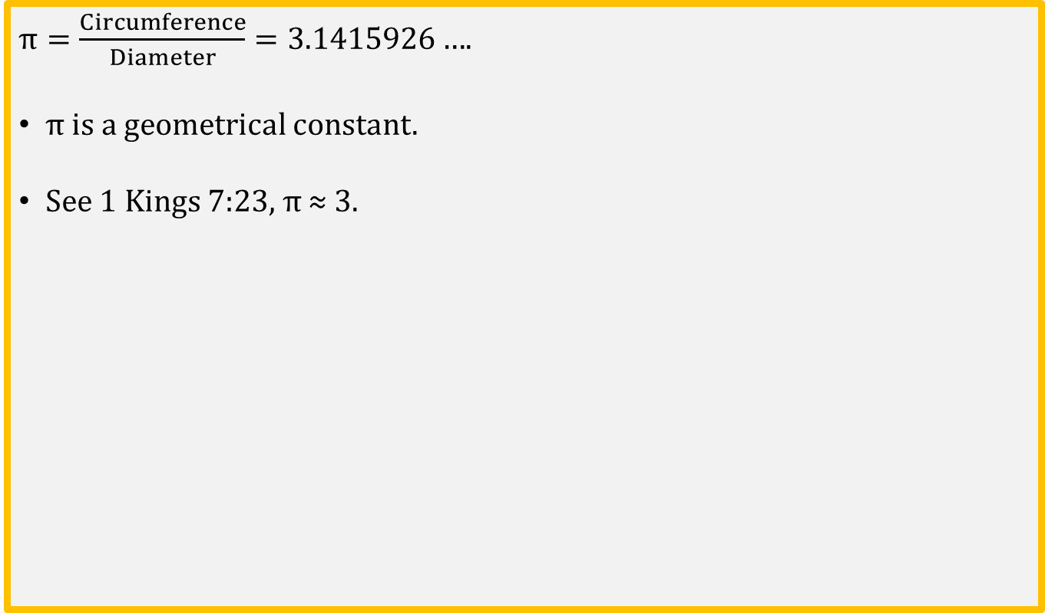
Definition of $π$
$π=\frac{Circumference}{Diameter}=3.1415926…$.
$π$is a geometrical constant.
See 1 Kings 7:23, $π$ ≈ 3.
Radius
Diameter

Slide 26
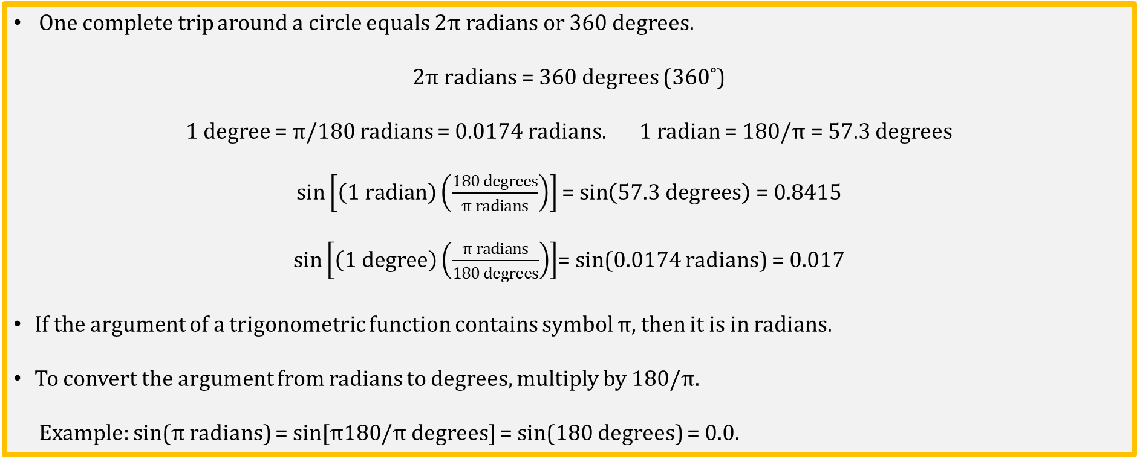
Degrees and Radians
One complete trip around a circle equals $2π radians$or 360 degrees$.$
$2π radians$ = 360 degrees (360˚)
1 degree = $π$/180 radians = 0.0174 radians. 1 radian = 180/$π$ = 57.3 degrees
$\sin\left[\left(1 radian\right)\left(\frac{180 degrees}{π radians}\right)\right]$ = $\sin\left(57.3 degrees\right)$ = 0.8415
$\sin\left[\left(1 degree\right)\left(\frac{π radians}{180 degrees}\right)\right]$= sin(0.0174 radians) = 0.017
If the argument of a trigonometric function contains symbol $π$, then it is in radians.
To convert the argument from radians to degrees, multiply by 180/$π$.
Example: sin($π$ radians) = sin[$π180$/$π$ degrees] = sin(180 degrees) = 0.0.

Slide 27
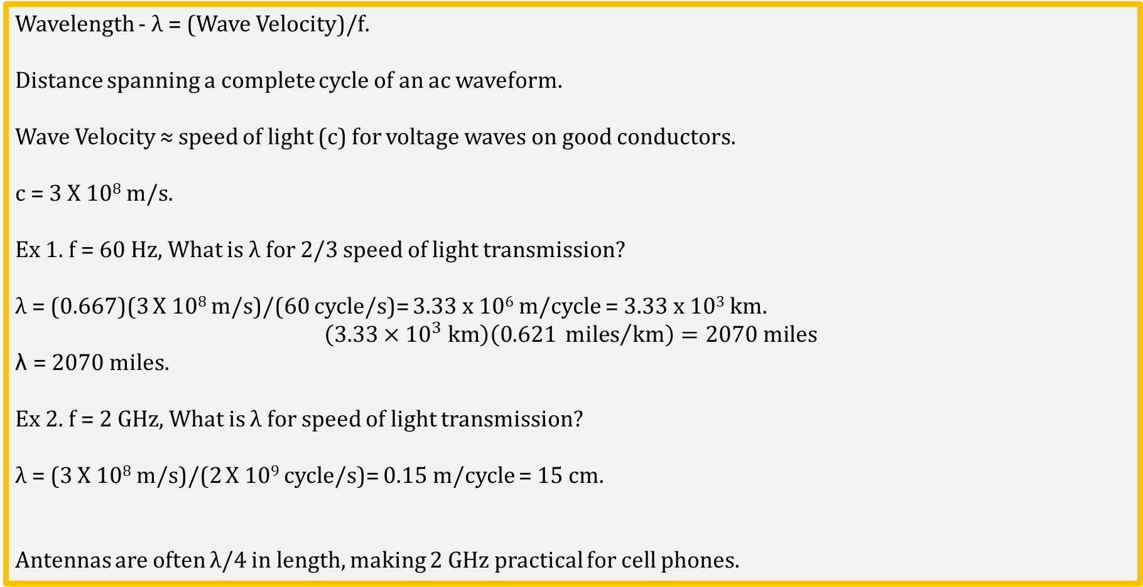
Wavelength
Wavelength - λ = (Wave Velocity)/f.
Distance spanning a complete cycle of an ac waveform.
Wave Velocity ≈ speed of light (c) for voltage waves on good conductors.
c = 3 X 10⁸ m/s.
Ex 1. f = 60 Hz, What is λ for 2/3 speed of light transmission?
λ = (0.667)(3 X 10⁸ m/s)/(60 cycle/s)= 3.33 x 10⁶ m/cycle = 3.33 x 10³ km.
$$\left(3.33×{10}^{3} km\right)\left(0.621 {miles}/{km}\right)=2070 miles.$$
λ = 2070 miles.
Ex 2. f = 2 GHz, What is λ for speed of light transmission?
λ = (3 X 10⁸ m/s)/(2 X 10⁹ cycle/s)= 0.15 m/cycle = 15 cm.
Antennas are often λ/4 in length, making 2 GHz practical for cell phones.

Slide 28
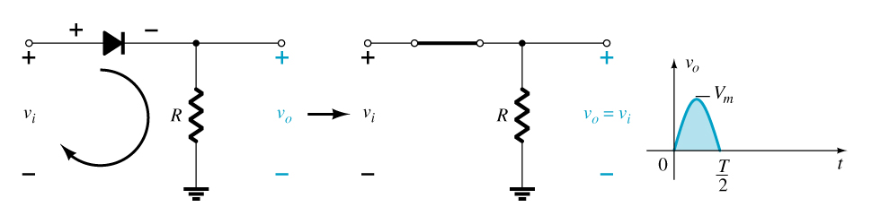
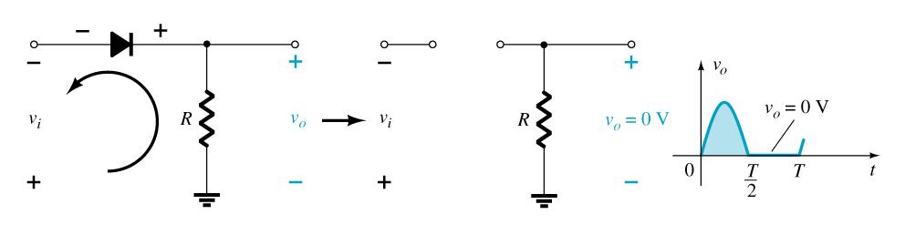
Rectification – AC to DC
Half-Wave Rectification
The diode conducts only when it is forward biased, therefore only half of the AC cycle passes through the diode to the output.
The DC output voltage is 0.318V_{m}, where V_{m} = the peak AC voltage.
Notes:
Image by instructor fg02_04500.jpg

Slide 29
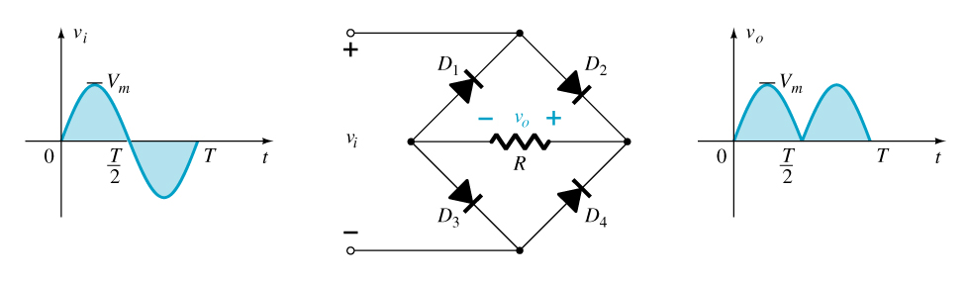
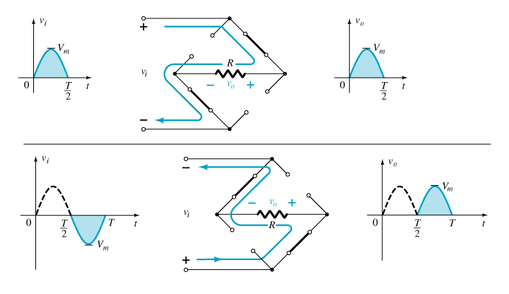
Rectification – AC to DC
Full-Wave Rectification
Bridge Rectifier
A full-wave rectifier with four diodes that are connected in a bridge configuration
V_{DC} = 0.637V_{m}
Notes:
Image by instructor

Slide 30
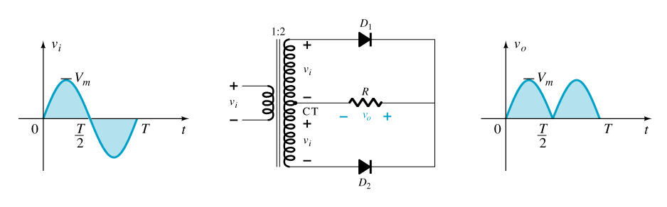
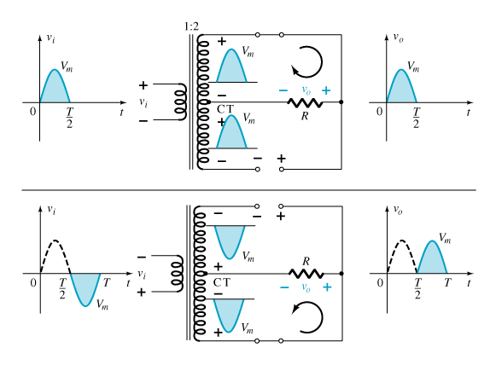
Rectification – AC to DC
Full-Wave Rectification
Center-Tapped
Transformer Rectifier
Requires two diodes and a
center-tapped transformer
V_{DC} = 0.637V_{m}
Notes:
Image by instructor

